Slide 1
Our approach to Omicron
January 2022
Presented by Manatū Hauora | Ministry of Health

Slide 2
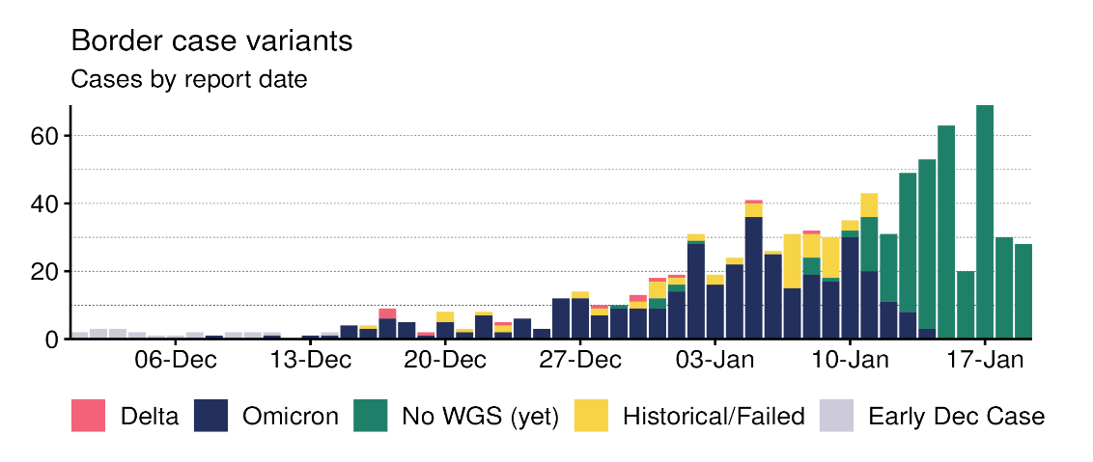
Setting the scene – our domestic situation
The community Delta outbreak is on its tail end, however Omicron cases amongst border returnees have increased substantially.
Border returnee cases have risen from around 20 cases detected fortnightly to 513 cases detected in the last 2 weeks.
Almost all returnee cases have the Omicron variant.
The Prime Minister announced that all of Aotearoa would move to Red setting on Sunday 23 January 2022, in response to the January Omicron cluster.

Slide 3
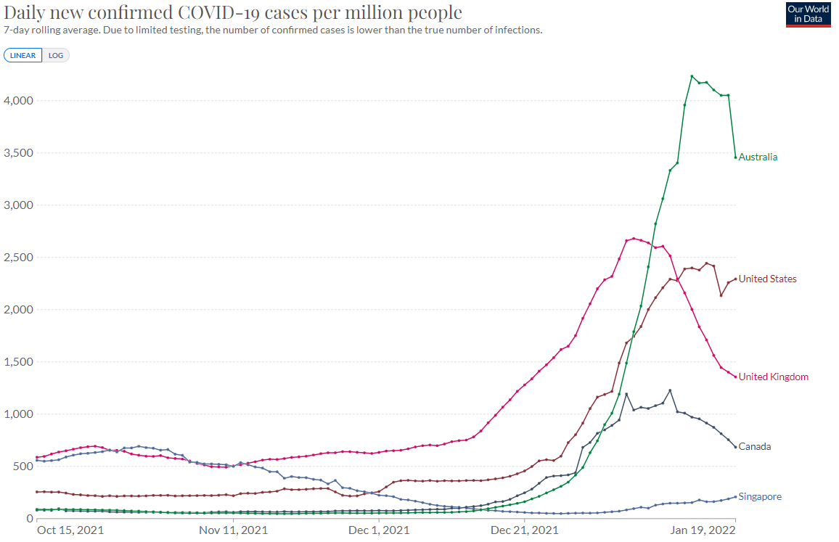
Setting the scene – the international situation
Daily reported COVID-19 cases globally are surging to record levels since December 2021.
3.1 million cases reported daily, 21 million cases reported in the past week.
7,797 global deaths reported daily.
Omicron is the predominant variant in at least 60 countries worldwide.
Omicron appears to reach an infection peak 3 – 4 weeks after it becomes the dominant strain (UK, approx. 24 days, US approx. 28 days).
While hospitalisations increase during Omicron surges, case hospitalisation rates are markedly lower than in previous outbreaks.

Slide 4
Setting the scene – some top of mind priorities
We are focused on some of the current priorities to support our Omicron response, including:
Use of Rapid Antigen Testing (RATs)
Use of masks and face coverings
Vaccination; issues under further consideration
Boosters for 12-17 year olds
Shortening the interval for receiving boosters
Shortening the interval between doses 5-11 year olds

Slide 5
Modelling scenarios inform our planning and response for Omicron
The Te Pūnaha Matatini COVID-19 modelling group (Sean Hendy, Michael Plank) are developing several scenarios for Omicron in New Zealand. Preliminary results are outlined below.
Preliminary results
Scenario | Peak daily reported cases | Peak daily hospital admission | Peak hospital bed occupancy
Low | ~6,000 | ~200 | ~750
Medium | ~17,500 | ~500 | ~2,000
High | ~25,000 | ~800 | ~3,250
Assumptions
‘Homogenous’ mixing of the population of New Zealand within age bands – this likely models more efficient transmission due to contacts than occurs in practice.
All models account for waning immunity.
Community transmission with 500 infections in the community in the week before 1 February.
90% of adults are boosted as they become eligible.
Changes to CPF or other measures in response to increasing epidemic curve not considered.
Doubling time of 3.5 days for all models. The effective R (Reff) and generation interval, GI, (time between case and contact’s infections) are varied.
Vaccine effectiveness follows preliminary data observed in UK for 2 and 3 doses.
Scenarios
Low: Reff=2.2, GI=3.3 days
Baseline/Medium: Reff=2.6, GI=3.3 days
High: Reff=3.4, GI=5 days (Note: similar assumptions to Delta)
Notes
In general, Omicron peaks occur within 2-3 months.
There is always a large degree of uncertainty based on large assumptions made in modelling.
Results are subject to change as Te Pūnaha Matatini are finalising models this week.

Slide 6
Phase One
Phase 1 | Scenario leading to ‘stamp it out’ stage | Operational Response
Situation: There are some cases in the community, but we continue to stamp it out | Testing | Current testing parameters continue. PCR testing for symptomatic and close contacts.
 | Case investigation and contact tracing | Cases identified via positive PCR. Cases isolate for 14 days. Contacts actively managed through NCTS and PHUs. Contacts isolate for 10 days. PHUs focus on complex cases and medium-high risk settings.
 | Health care | Some cases use self service tools such as online contact forms. Clinical care by primary care teams and support by Care Coordination Hubs. Most cases supported to isolate at home.

Slide 7
Phase Two
Phase 2 | Scenario leading to ‘stamp it out’ stage | Operational Response
Situation: Cases have spread in the community so we need to minimise and slow further spread and assist our vulnerable communities | Testing | RATS may be used in addition to PCR testing for symptomatic people and close contacts. ‘Test to return’ if needed for asymptomatic healthcare and critical workforce who are close contacts using RATs. PCR to confirm diagnosis if positive RAT.
 | Case investigation and contact tracing | Cases identified via positive PCR. Cases isolate for 10 days. Contacts actively managed through NCTS and PHUs. Contacts isolate for 7 days. Increased use of digital pathways e.g. notification via text, self investigation web based tool. PHUs focus on high priority cases and medium-high risk settings.
 | Health care | Cases using self service where possible. Clinical care by primary care teams focussing on people who need ongoing clinical care. Cases supported to isolate at home.

Slide 8
Phase Three
Phase 3 | Scenario leading to ‘stamp it out’ stage | Operational Response
Situation: There are thousands of cases per day: most people will self-manage and health and social services focus on families and communities that have the highest needs | Testing | Focus PCR testing on priority populations testing priority populations and critical workforces. RATS available at GPs, pharmacies, Community Testing Centres or workplaces for symptomatic people or critical workers. Symptomatic or priority populations may use a RAT for diagnosis ‘Test to return’ for asymptomatic healthcare and critical workforce who are close contacts using RAT.
 | Case investigation and contact tracing | Cases identified via positive PCR, RATs or symptoms, 10 days isolation. Contacts automatically notified from online self-investigation by cases and option for cases to self-notify contacts, 7 days isolation. PHUs focus on outbreak management and very high risk settings with support from NCIS.
 | Health care | Majority of positive cases self-manage. Clinical care and welfare support focusses on those with high needs.

Slide 9
Equity first – who is most at risk​?
Equitable outcomes, particularly for our disadvantaged populations, are essential to every pillar of our Omicron response.
Poor outcomes
People over 60 years of age
Pregnant people
People with other conditions such as cardiovascular, respiratory, diabetes, inflammatory conditions, immunodeficient states, autoimmune diseases, and mental health issues
People with poor access to healthcare and prevention services
Casual/contract workers
People in aged residential care facilities and hospitals
Higher transmission
Young adults age 18-35
People at large/high density indoor events
People in temporary housing, overcrowded housing, poor ventilation
People in prisons
Healthcare staff
People who work in frontline services like transport operators and food and beverage workers
Unvaccinated people
Māori and Pacific communities
Disabled people
People with drug/alcohol addiction
People who experience high levels of material deprivation

Slide 10
Health system preparedness for Omicron
We’re rapidly adjusting our approach and response to the new challenges presented by Omicron.
Health System Preparedness – what we’ve changed in response to Omicron
DHB preparedness and contingency planning have been reviewed considering Omicron scenarios.
Workforce planning continues to ensure that service delivery can be maintained under Omicron scenarios.
Health regional coordination in place to coordinate and prioritise community, primary and hospital level care.
Care in the Community – what we’ve changed in response to Omicron
Providing more options for self-service to enable the health system to focus on COVID-positive individuals and whānau with high clinical need.
Planning scaling up activities with our Care in the Community central agencies to allow the whole system to jointly respond to Omicron.
Risk stratification to identify at risk individuals and whānau to enable the appropriate level of clinical care and welfare support.
COVID-19 therapeutics to support care in the community.

Slide 11
Working with you
It is essential we work together closely with you, the sector to implement an effective response to Omicron.
Using our existing working groups, advisory groups and clinical advisory groups.
Establishing sub-groups.
Including Health New Zealand and Māori Health Authority in these groups.
We welcome feedback on our approach.

